Slide 1
课程内容
第八章
应用机器学习的建议
决定下一步做什么
评估一个假设
模型选择和交叉验证集
诊断偏差和方差
正则化和偏差/方差
学习曲线
决定下一步做什么
类偏斜和误差度量
第九章
支持向量机
优化目标
大边界的直观理解
大边界的数学原理
核函数1
核函数2
使用支持向量机
第十章
无监督学习
聚类
无监督学习：简介
K-均值算法
优化目标
随机初始化
选择聚类数
降维
动机
主成分分析
选择主成分的数量
重建的压缩表示
主成分分析法的应用建议
第十一章
有趣的应用
异常检测
问题的动机
高斯分布
算法
开发和评价一个异常检测系统
选异常检测和监督学习对比
选择特征
推荐系统
问题形式化
基于内容的推荐系统
协同过滤
协同过滤算法

Slide 2

Problem motivation
Anomaly detection
Machine Learning

Slide 3
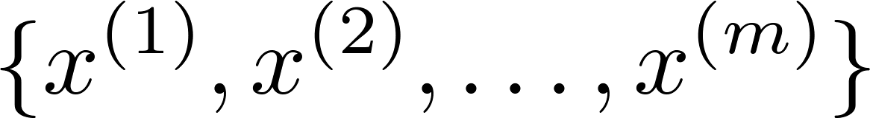





无监督学习算法
Anomaly detection example
Aircraft engine features:
= heat generated
= vibration intensity
…
Dataset:
New engine:
(vibration)
OK
Anomaly
(heat)
Notes:
我们假使数据集是正常的，我们希望知道新的数据 是不是异常的，即这个测试数据不属于该组数据的几率如何。

Slide 4

Density estimation
Dataset:
Is anomalous?
建立P(x)!!! 密度估计
(vibration)
OK
Anomaly
(heat)

Slide 5





Anomaly detection example
Fraud detection:
= features of user ’s activities
  Model from data.
  Identify unusual users by checking which have
Monitoring computers in a data center.
  = features of machine
  = memory use, = number of disk accesses/sec,
  = CPU load, = CPU load/network traffic.
  …
Notes:
异常检测主要用来识别欺骗。例如在线采集而来的有关用户的数据，一个特征向量中可
能会包含如：用户多久登录一次，访问过的页面，在论坛发布的帖子数量，甚至是打字速度
等。尝试根据这些特征构建一个模型，可以用这个模型来识别那些不符合该模式的用户

Slide 6
Gaussian distribution
Anomaly detection
Machine Learning

Slide 7
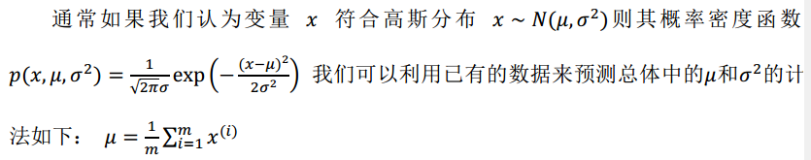
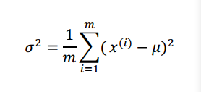
Gaussian (Normal) distribution
Notes:
Add dots

Slide 8
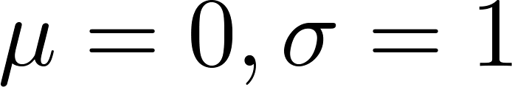
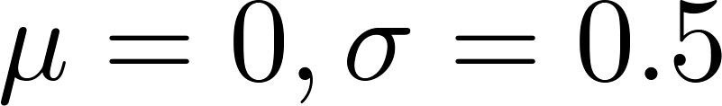
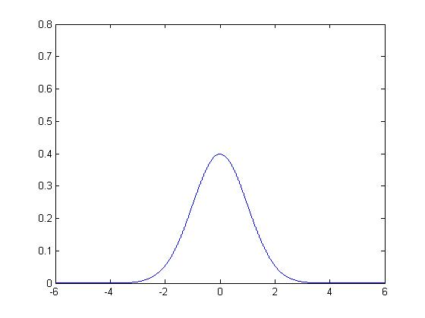
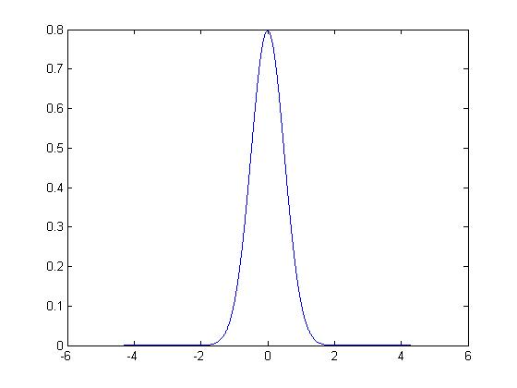
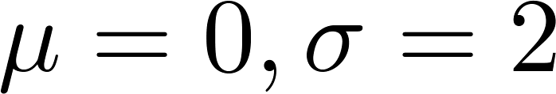
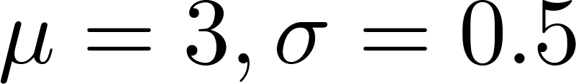
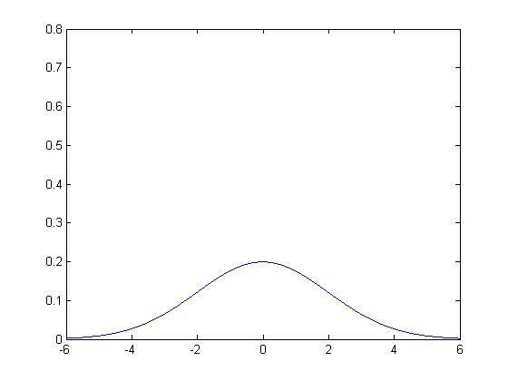
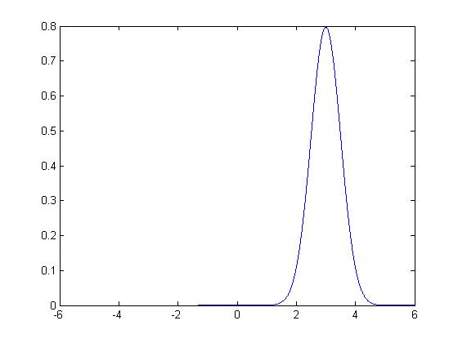
Gaussian distribution example
Notes:
机器学习中对于方差我们通常只除以m而非统计学中的(m− 1)。这里顺便提一下，
在实际使用中，到底是选择使用1/m还是1/(m− 1)其实区别很小，只要你有一个还算大的
训练集，在机器学习领域大部分人更习惯使用1/m这个版本的公式。这两个版本的公式在理
论特性和数学特性上稍有不同，但是在实际使用中，他们的区别甚小，几乎可以忽略不计。

Slide 9
Algorithm
Anomaly detection
Machine Learning

Slide 10

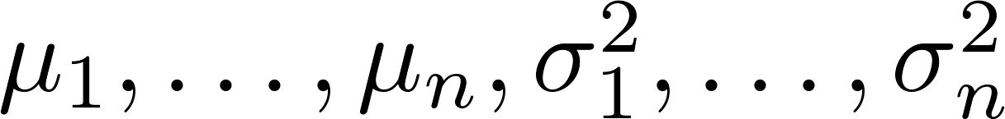
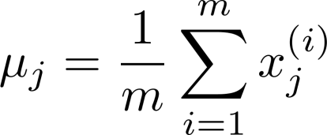
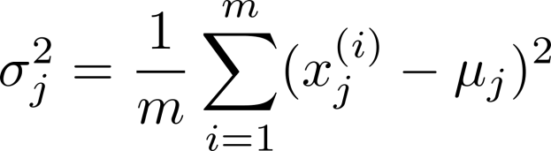


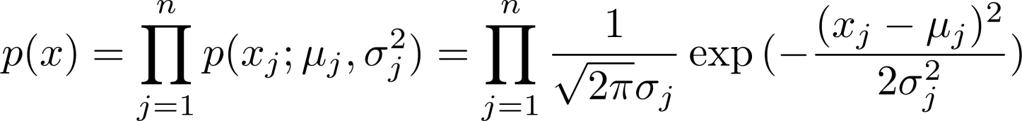
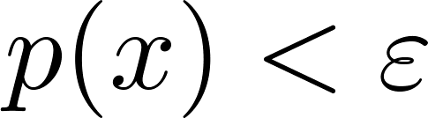
Anomaly detection algorithm
Choose features that you think might be indicative of anomalous examples.
Fit parameters
Given new example , compute :
Anomaly if
Notes:
Change numbers to LATEX as well

Slide 11
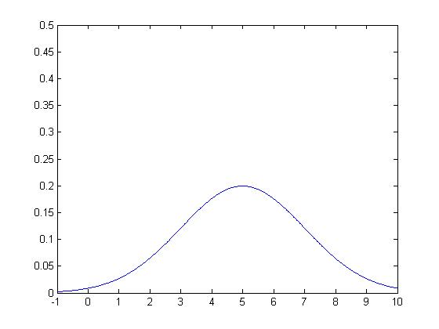
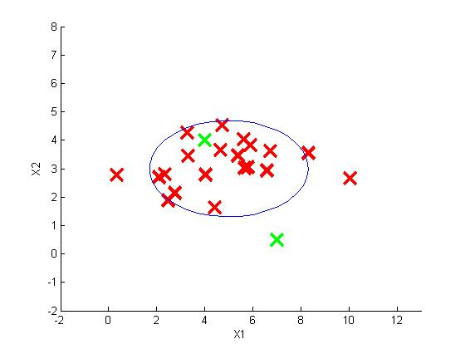
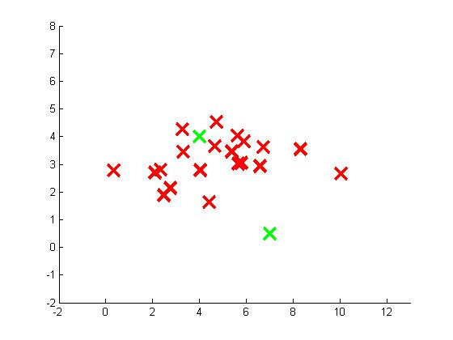
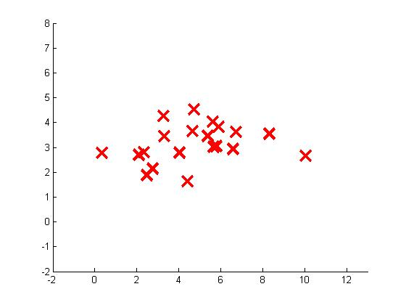
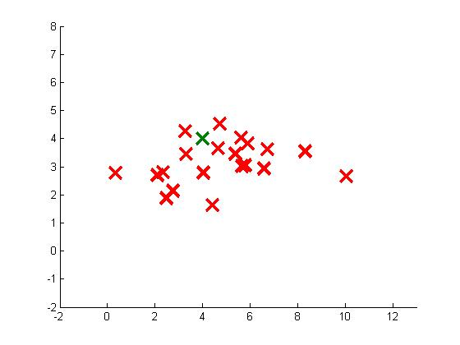

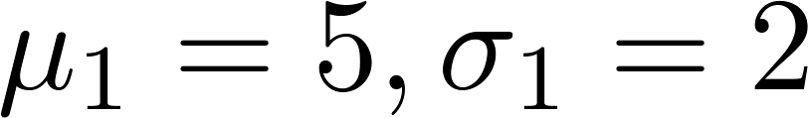


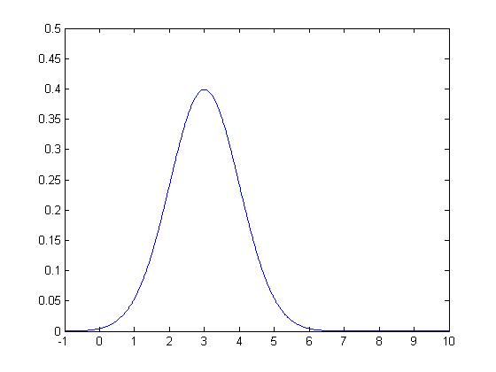
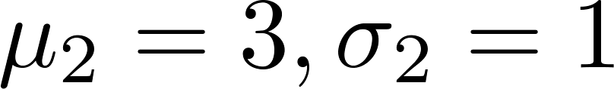

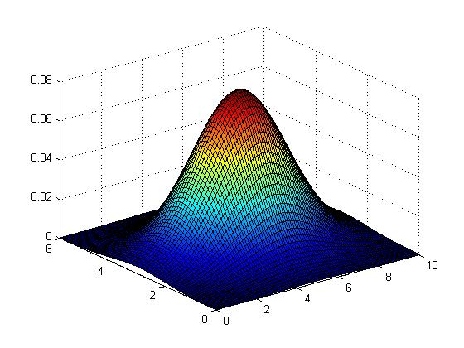

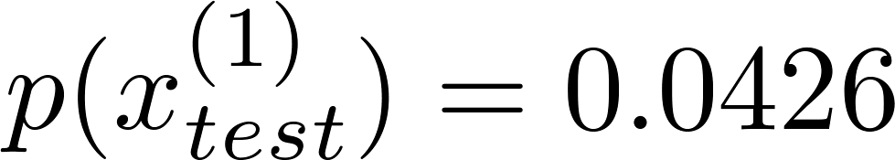
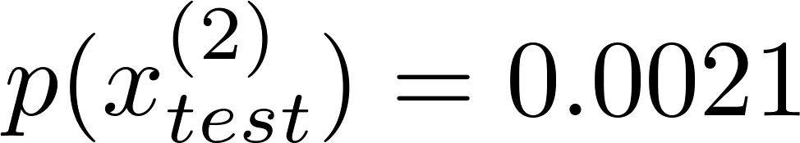
Anomaly detection example
Notes:
Add animation to block left graph

Slide 12
Developing and evaluating an anomaly detection system
Anomaly detection
Machine Learning

Slide 13


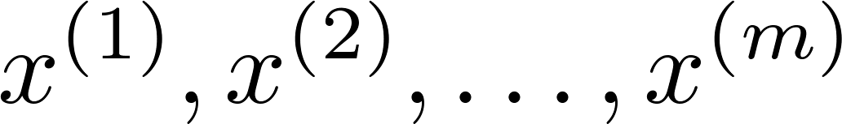
The importance of real-number evaluation
When developing a learning algorithm (choosing features, etc.), making decisions is much easier if we have a way of evaluating our learning algorithm.
Assume we have some labeled data, of anomalous and non-anomalous examples. ( if normal, if anomalous).
Training set: (assume normal examples/not anomalous)
Cross validation set:
Test set:
Notes:
Replace as previous; change spacing to fill page

Slide 14
Aircraft engines motivating example
10000 good (normal) engines
20 flawed engines (anomalous)
Training set: 6000 good engines
CV: 2000 good engines ( ), 10 anomalous ( )
Test: 2000 good engines ( ), 10 anomalous ( )

Slide 15
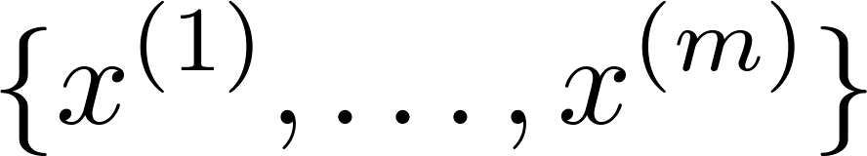
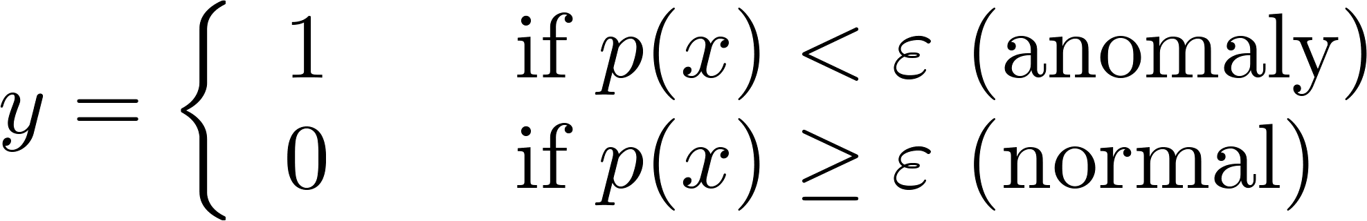
Algorithm evaluation
Fit model on training set
On a cross validation/test example , predict
Possible evaluation metrics:
- True positive, false positive, false negative, true negative
- Precision/Recall
- F₁-score
Can also use cross validation set to choose parameter

Slide 16
Anomaly detection vs. supervised learning
Anomaly detection
Machine Learning

Slide 17
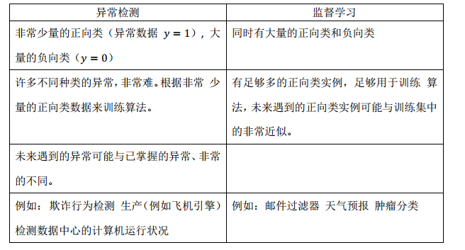
Notes:
Make points have 0 mean on x1 and x2

Slide 18
Choosing what features to use
Anomaly detection
Machine Learning

Slide 19
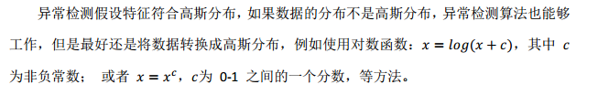
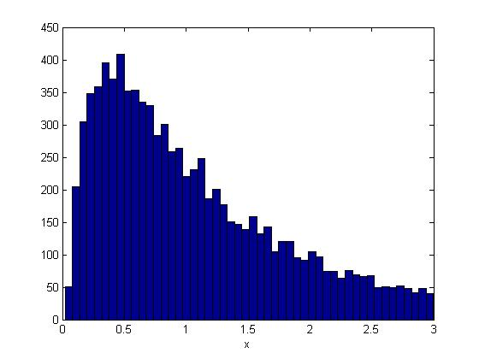
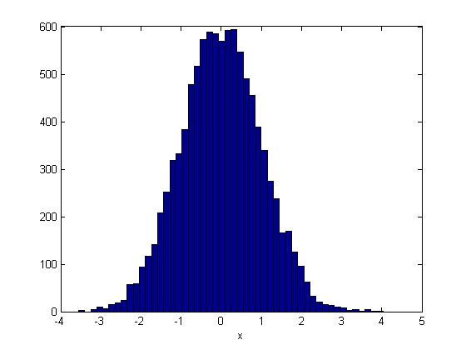

Non-gaussian features

Slide 20
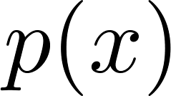

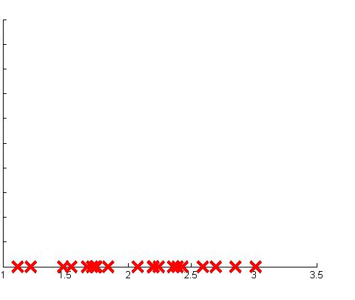
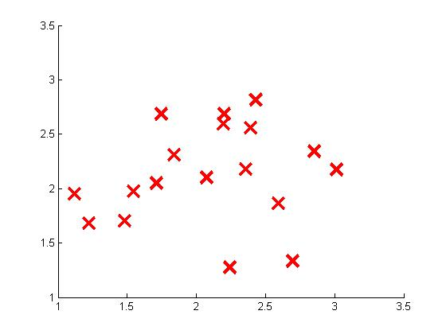
Error analysis for anomaly detection
Want large for normal examples .
small for anomalous examples .
Most common problem:
is comparable (say, both large) for normal and anomalous examples
Anomaly
Notes:
一个常见的问题是一些异常的数据可能也会有较高的()值，因而被算法认为是正常的。
这种情况下误差分析能够帮助我们，我们可以分析那些被算法错误预测为正常的数据，观察
能否找出一些问题。我们可能能从问题中发现我们需要增加一些新的特征，增加这些新特征
后获得的新算法能够帮助我们更好地进行异常检测。
我们通常可以通过将一些相关的特征进行组合，来获得一些新的更好的特征（异常数据
的该特征值异常地大或小）

Slide 21
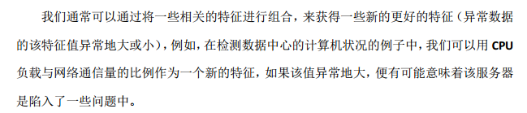




Monitoring computers in a data center
Choose features that might take on unusually large or small values in the event of an anomaly.
= memory use of computer
= number of disk accesses/sec
= CPU load
= network traffic

Slide 22
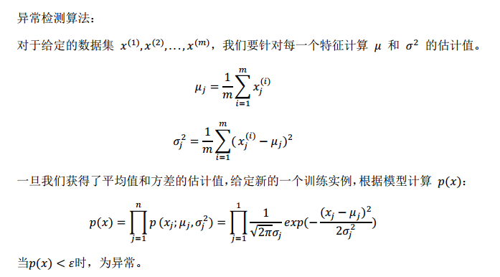
考查要点

Slide 23
考查要点

Slide 24
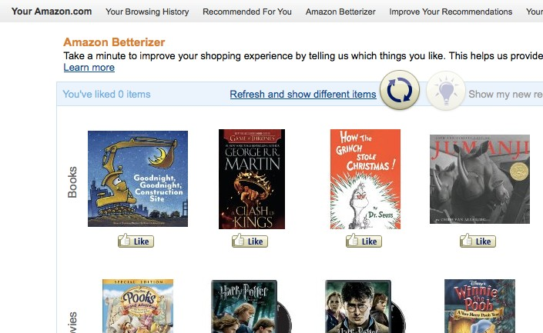
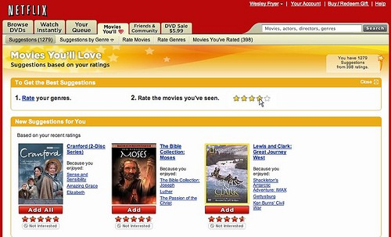
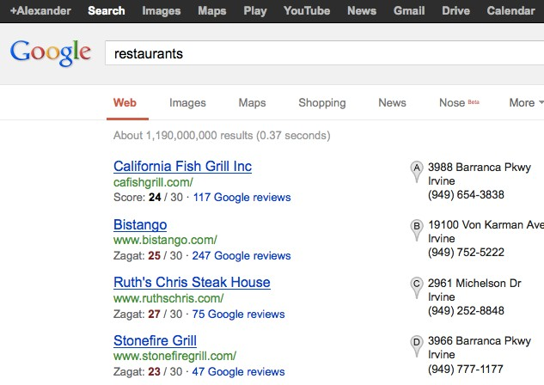
Recommender systems: examples

Slide 25
Problem formulation
Recommender Systems
Machine Learning

Slide 26





Example: Predicting movie ratings
User rates movies using one to five stars
Movie | Alice (1) | Bob (2) | Carol (3) | Dave (4)
Love at last | 5 | 5 | 0 | 0
Romance forever | 5 | ? | ? | 0
Cute puppies of love | ? | 4 | 0 | ?
Nonstop car chases | 0 | 0 | 5 | 4
Swords vs. karate | 0 | 0 | 5 | ?
= no. users
= no. movies
= 1 if user has rated movie
= rating given by user to movie (defined only if
)
我们希望构建一个算法来预测他们每个人可能会给他们没看过的电影打多少分，并以此作为推荐的依据。

Slide 27
Content-based recommendations
Recommender Systems
Machine Learning

Slide 28



Content-based recommender systems
Movie | Alice (1) | Bob (2) | Carol (3) | Dave (4) | (romance) | (action)
Love at last | 5 | 5 | 0 | 0 | 0.9 | 0
Romance forever | 5 | ? | ? | 0 | 1.0 | 0.01
Cute puppies of love | ? | 4 | 0 | ? | 0.99 | 0
Nonstop car chases | 0 | 0 | 5 | 4 | 0.1 | 1.0
Swords vs. karate | 0 | 0 | 5 | ? | 0 | 0.9
For each user , learn a parameter . Predict user as rating movie with stars.

Slide 29






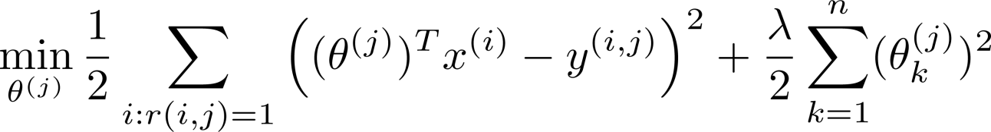
Problem formulation
  if user has rated movie (0 otherwise)
  rating by user on movie (if defined)
= parameter vector for user
= feature vector for movie
For user , movie , predicted rating:
= no. of movies rated by user
To learn :
代价函数

Slide 30
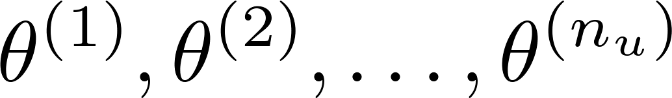
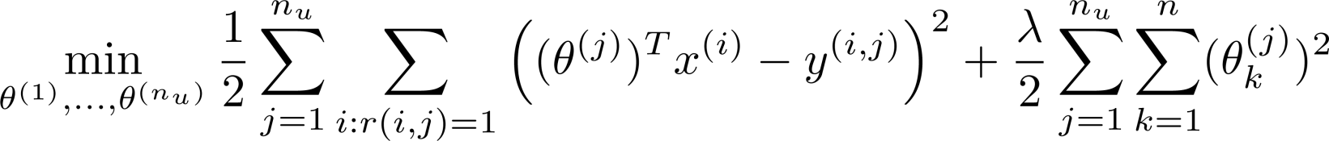
Optimization objective:
To learn (parameter for user ):
针对一个用户
To learn :
针对所有用户

Slide 31
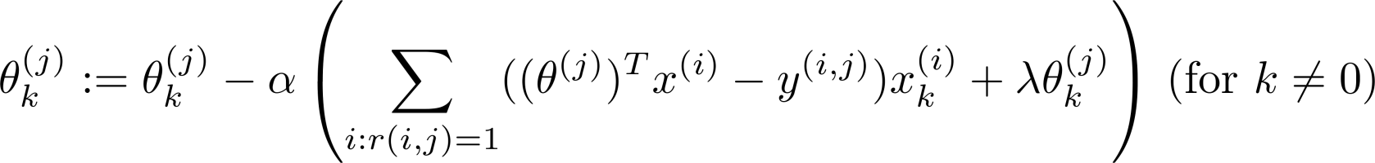
Optimization algorithm:
Gradient descent update:

Slide 32
Recommender Systems
Collaborative filtering
协同过滤
Machine Learning

Slide 33
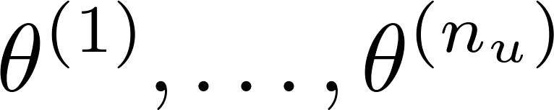
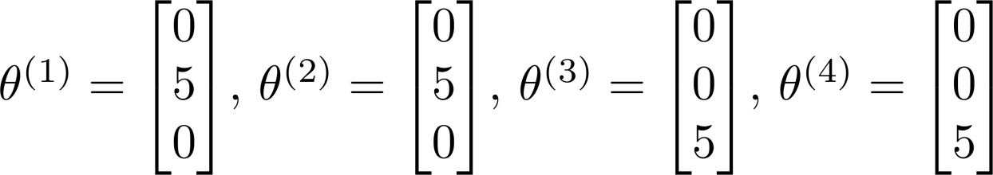
Problem Motivation
针对一个电影特征
Given , to learn
Movie | Alice (1) | Bob (2) | Carol (3) | Dave (4) | (romance) | (action)
Love at last | 5 | 5 | 0 | 0 | ？ | ？
Romance forever | 5 | ? | ? | 0 | ？ | ？
Cute puppies of love | ? | 4 | 0 | ? | ？ | ？
Nonstop car chases | 0 | 0 | 5 | 4 | ？ | ？
Swords vs. karate | 0 | 0 | 5 | ? | ？ | ？

Slide 34
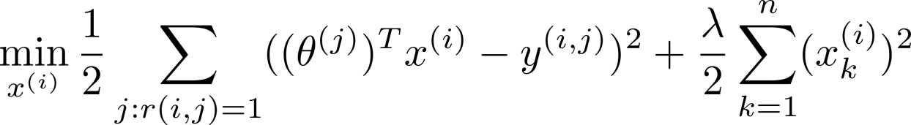
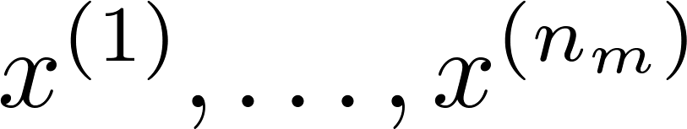

Optimization algorithm
针对一个电影特征
Given , to learn :
Given , to learn :
针对所有电影特征

Slide 35


Collaborative filtering
Given (and movie ratings),
can estimate
Given ,
can estimate

Slide 36
Recommender Systems
Collaborative filtering algorithm
Machine Learning

Slide 37


Collaborative filtering optimization objective
Given , estimate :
Given , estimate :
Minimizing and simultaneously:

Slide 38



Collaborative filtering algorithm
Initialize to small random values.
Minimize using gradient descent (or an advanced optimization algorithm). E.g. for every :
For a user with parameters and a movie with (learned) features , predict a star rating of .

Slide 39

考查要点
协同过滤

